Slide 1
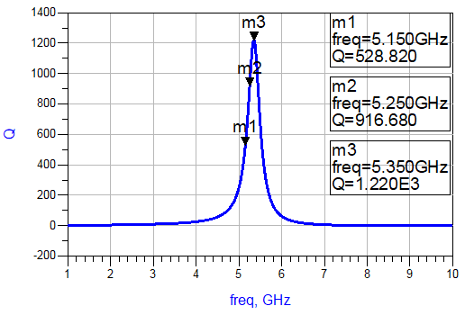
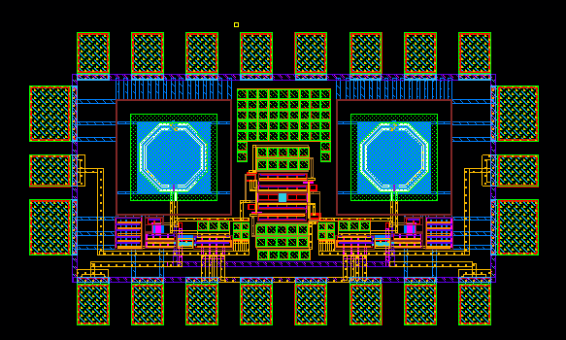
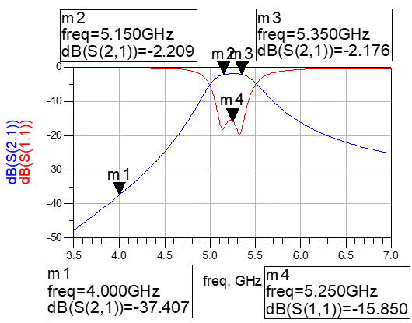
CMOS Microwave Bandpass Filter Using High Q Active Inductor
Qi Wang and Yongchae Jeong
Jeonbuk National University, Jeonju, Republic of Korea
OUTLINE: CMOS bandpass filters(BPFs) usually have relatively low Q-factors and low operating frequencies due to the passive spiral inductors and capacitors. The proposed BPF can improve these drawbacks by using high Q active inductor. We can get 2.2 dB of insertion loss at -10 dBm input power level in the passband from measurement.
CIRCUIT DESIGN: The gyrator-C consists of two transistors and generates inductive reactance from parasitic capacitances of those transistors. However, the conventional grounded active inductor (GAI) has a limitation to increase the Q factor and operating frequency range. The GAI using feedback parallel resonator has the prominent effect on increasing Q factor of GAI, which is adopted in BPF design to get high Q factor.
Fig. 1 High Q GAI and Q factor performance
In this paper, the capacitive coupled BPF is designed with 1-port active inductor using feedback parallel resonator. In the design of conventional BPF, the prototype LPF is designed at first and then transformed to the BPF by transforming low pass prototype lumped elements to serial or parallel resonant circuits. In this paper, J-inverters using capacitors are used in order to save circuit size.
Fig. 2 Structure of proposed BPF.
Fig. 3 Layout and measurement result of proposed BPF.
The center frequency of the designed BPF is 5.25 GHz and it has a wide bandwidth around 200 MHz for IEEE 802.11a band of WLAN applications. The proposed BPF is simulated with 65 nm Samsung RF CMOS technology, which demonstrates an insertion loss smaller than 2.2 dB and return loss higher than 15.85 dB. The fabricated circuit occupies 500 um × 600 um chip size and has good passband and return loss characteristics. The proposed circuit consumes 7.2 mW DC power at 1.2 V supply voltage, which is promising for the application of microwave circuit systems.
CONCLUSION: In this work, Microwave CMOS BPF has been proposed. The proposed BPF consists of MIM (metal-insulator-metal) and high Q active inductors using feedback parallel resonator. Many CMOS BPFs in previous researches had relatively low Q-factors and low operating frequencies due to the passive spiral inductors and capacitors. The proposed BPF can improve these drawbacks by using high Q active inductor. This design method can greatly contribute to microwave CMOS circuit and system designs.
ACKNOWLEDGEMENT:
The chip fabrication and EDA tool were supported by the IC Design Education Center(IDEC), Korea.

